Slide 1
Gym member exercise tracking

Slide 2
Dataset Analysis:
The dataset has 973 records and 15 columns
Dimensions:
Gender: Male/Female
Workout Type: Types of workouts
Measures:
Age: Numeric
Weight (kg): Numeric
Height (m): Numeric
Max BPM: Numeric
Avg BPM: Numeric
Resting BPM: Numeric
Session Duration (hours): Numeric
Calories Burned: Numeric
Fat Percentage: Numeric
Water Intake (liters): Numeric
Workout Frequency (days/week): Numeric
BMI: Numeric
Experience Level: Levels of experience

Slide 3
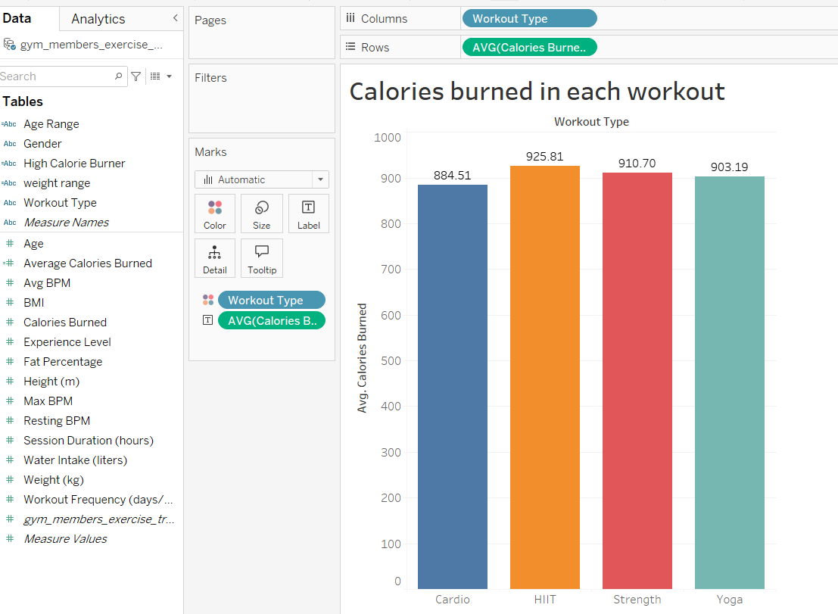
Explanation:
The visualization is a bar chart
In this case, we're comparing the "Average Calories Burned" across different workout types.
The x-axis lists the workout types (Cardio, HIIT, Strength, Yoga), and the y-axis represents the average calories burned.
The height of each bar corresponds to the average calories burned for that particular workout type

Slide 4
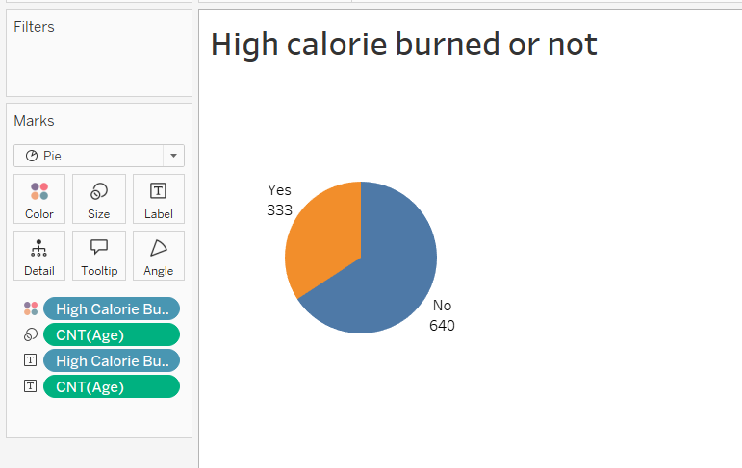
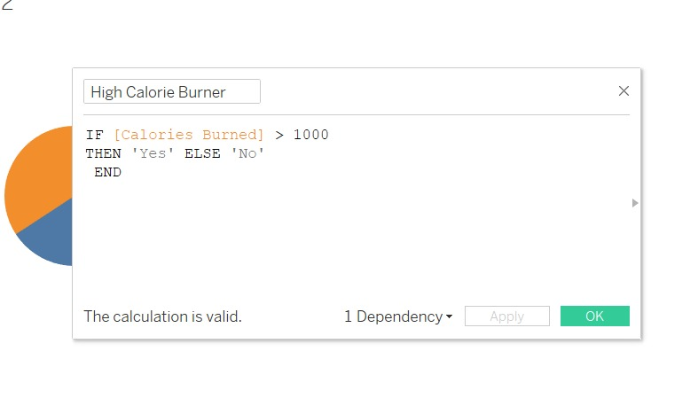
Explanation:
This visualization is a pie chart,
The pie chart shows the distribution of gym members based on whether they are high-calorie burners or not.
High Calorie Burner: This is a categorical variable with two categories: "Yes" (high-calorie burner) and "No" (not a high-calorie burner).
CNT(Age): This likely represents the count of gym members in each category.

Slide 5
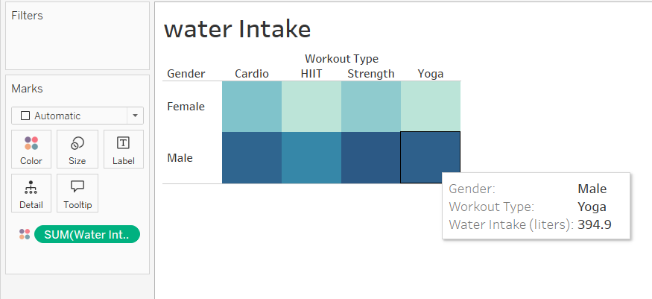
Explanation:
This visualization is a heat map
The heat map shows the water intake (in liters) for different workout types (Cardio, HIIT, Strength, Yoga) across two genders (Male and Female).
The color intensity of each cell represents the water intake, with darker shades indicating higher water intake

Slide 6
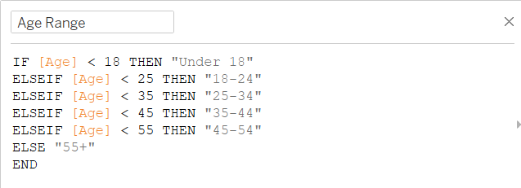
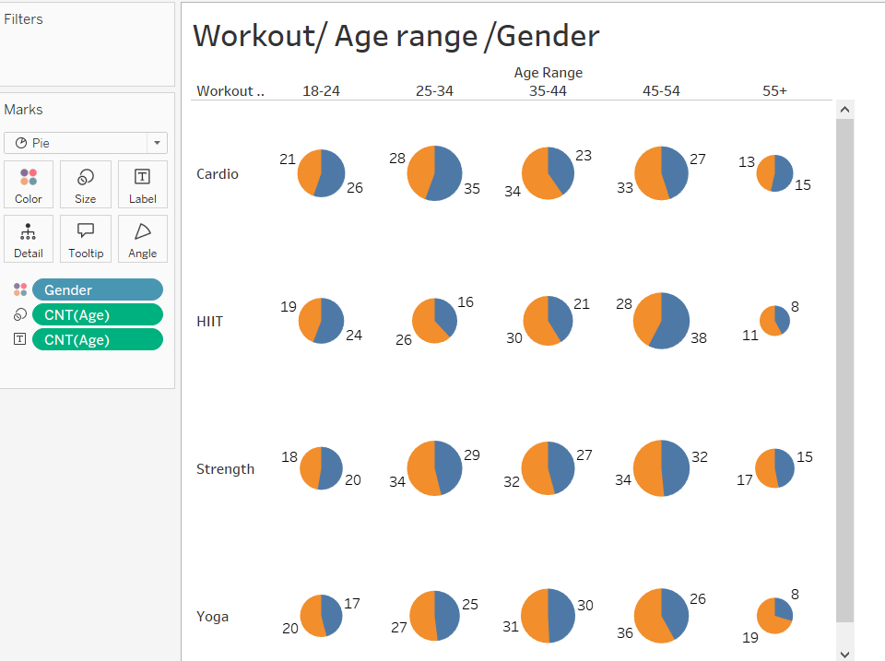
Explanation:
The visualization you provided is a series of pie charts that show the distribution of genders (male and female) across different age ranges for each workout type (Cardio, HIIT, Strength, Yoga).
Blue is female , yellow is male

Slide 7
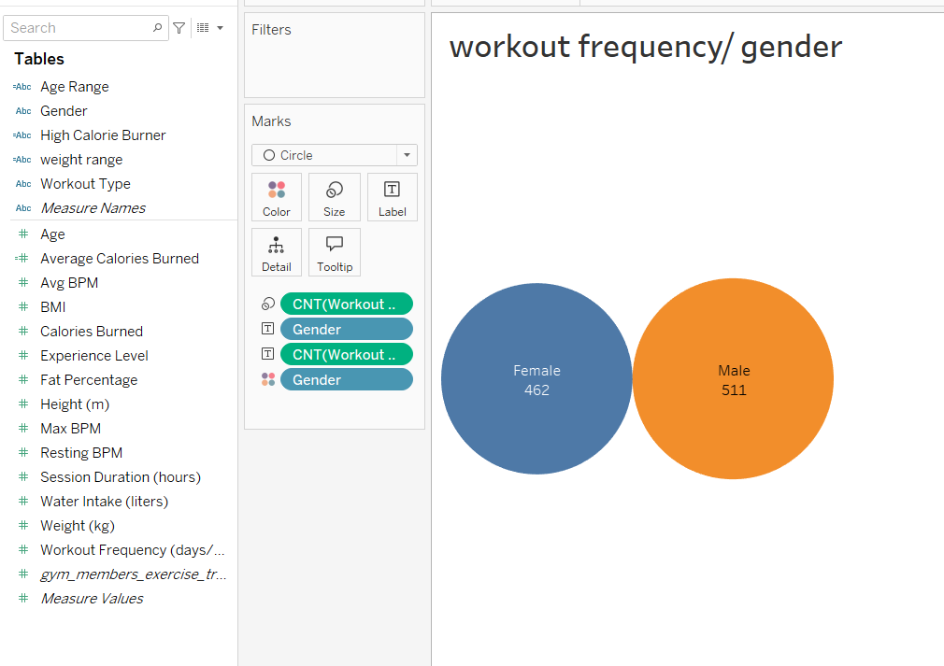
Explanation:
The visualization you provided is a Venn diagram, which is used to show the relationship between two sets of data.
The two sets represent the gender of gym members - "Female" and "Male“.
CNT(Workout Frequency (days/week)): This likely represents the count of gym members in each gender category

Slide 8
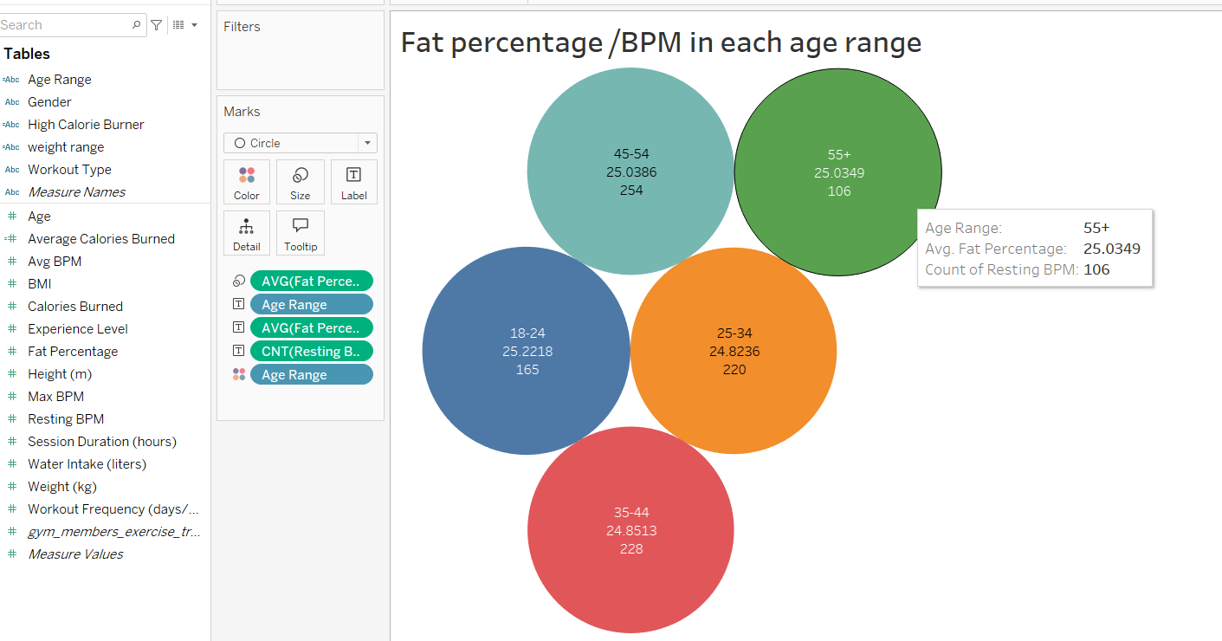
Explanation:
The visualization is a Venn diagram that shows the distribution of fat percentage and resting BPM across different age ranges
This visualization provides an overview of how fat percentage and resting heart rate might vary across different age groups.

Slide 9
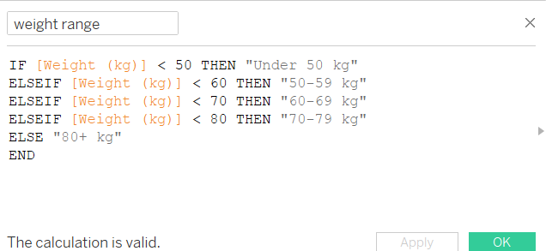
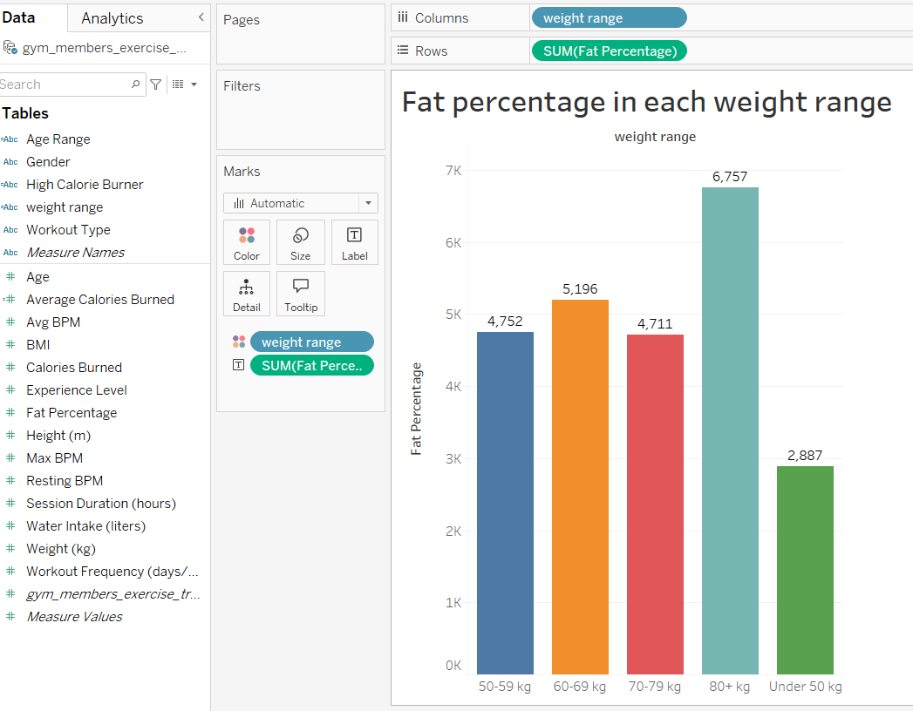
Explanation:
The visualization you've provided is a bar chart
It shows the distribution of fat percentage across different weight ranges

Slide 10
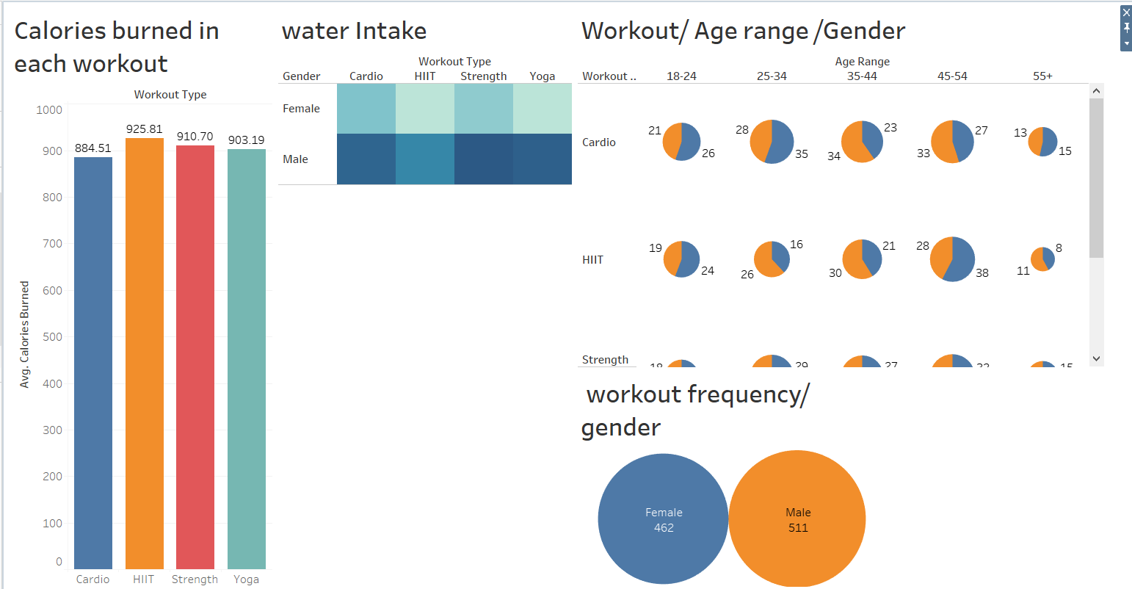
The dashboard presents a comprehensive overview of fitness data, analyzing factors like workout type, age, gender, and water intake. It includes visualizations like bar charts, heatmaps, pie charts, and Venn diagrams to compare average calories burned, water intake patterns, gender distribution across age groups, and workout frequency by gender. This enables you to identify trends, make comparisons, and gain insights into fitness behaviors.

Slide 11
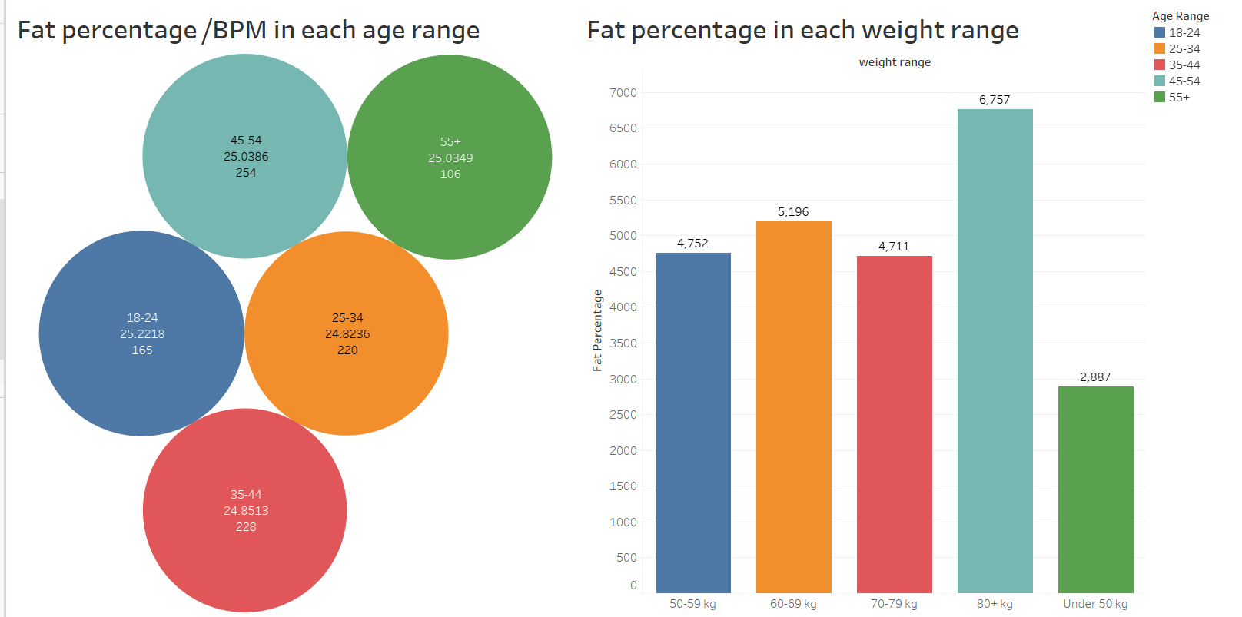
The provided visualizations offer insights into the relationship between age, weight, fat percentage, and resting heart rate (BPM). Venn diagrams illustrate how fat percentage and BPM vary across age groups, showing a general increase in fat percentage with age. Bar charts reveal the impact of weight on fat percentage, with higher weight ranges associated with higher fat percentages. These findings suggest that both age and weight are factors influencing body composition and heart health.

Slide 12
